Slide 1
AI Enabled Candidate Resume Screening Application
TEAM : CSE_AIML_D10

Slide 2
INTRODUCTION:
Artificial intelligence has made huge inroads into the human resource domain lately.
Companies are now deploying AI tools to reduce or eliminate time-consuming tasks in the recruitment process.
According to experts, screening resumes is the most critical, albeit, the most labour -intensive and challenging task for HR personnel.

Slide 3
PROBLEM STATEMENT:
Screening resumes and finding the best among them is considered one of the most tedious tasks in the recruitment process.
It has been a manual process for decades.
Now AI has challenged this traditional approach and automate the process with much higher accuracy.
When a single position attracts hundreds (or even thousands) of resumes, there’s no time to sift through them all. The applications will be all over the map and require hours and hours of screening.

Slide 4
PROPOSED SOLUTION:
Using recruiting automation or AI resume screening is a potential solution to this problem.
A resume parsing software can do it in a few seconds and saves most of the time of recruiters. It extracts candidate information from resumes and hire them according to their skills.
AI provides a simple way not only to reach out to possible candidates, but also screen and shortlist their resumes based on the skills most relevant to your company.
This application is used to screen the applicant's resume and send an email alert regarding their candidature.

Slide 5
ADVANTAGES:
Save recruiters time: A resume parsing software can do it in a few seconds and saves most of the time of recruiters.
Find the best candidate:The AI tools help to eliminate such irrelevancy by making accurate resume screening using proper keyword matching. It increases the chances of interviewing the most potential candidates for a job opening.
Reduce manual efforts: AI tools are programmed to eliminate human efforts.

Slide 6
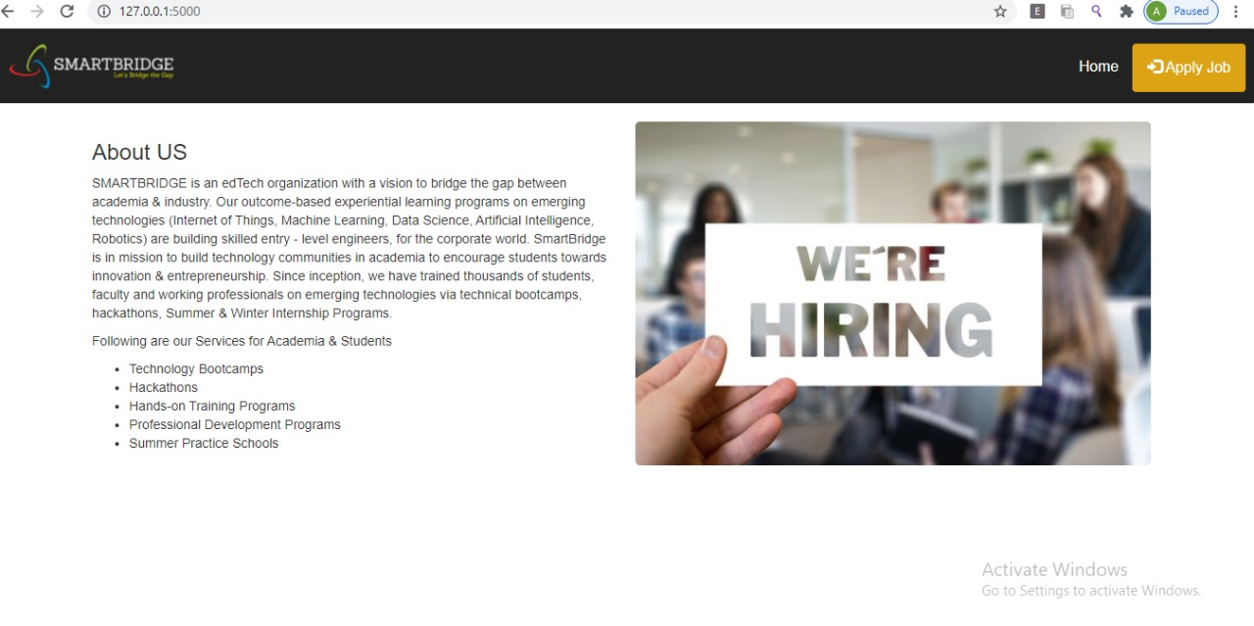
SAMPLE OUTPUTS:

Slide 7
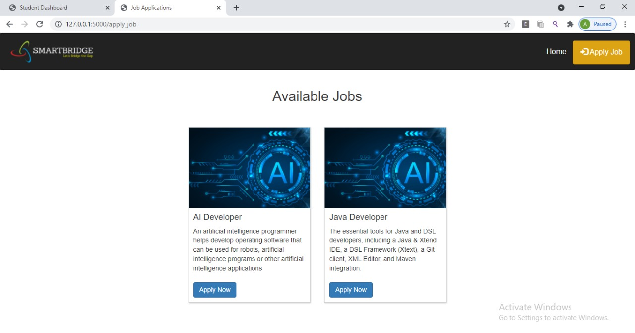

Slide 8
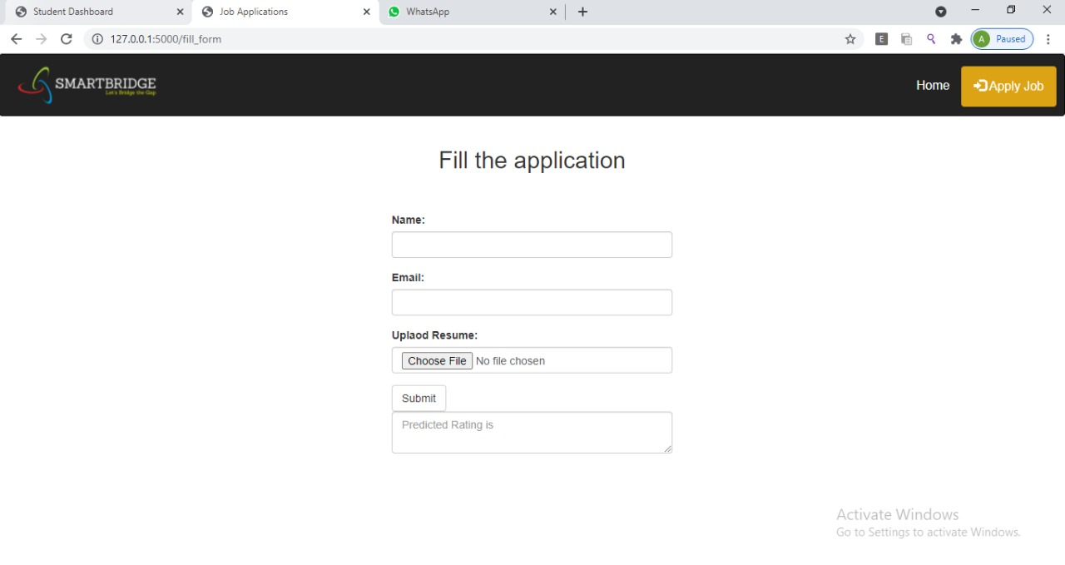

Slide 9
